Slide 1
NSQ1, Session 10
The Cypher Language

Slide 2
Cypher
Patterns
Paths
MATCH/OPTIONAL MATCH
RETURN
WITH
UNWIND
WHERE
SET
DELETE

Slide 3
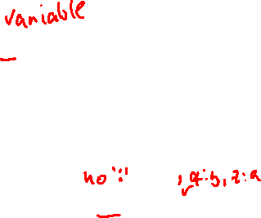
Patterns (nodes)
(), (v) Any node
(:L), (v:L) Nodes that have the label L
({p:x}), (v{p:x}) Nodes that have x as the value of property p
(v:L{p:x}) All of the above

Slide 4
Patterns (relationships)
()-[]-(), ()-[e]-() Any relationship in any direction
()-[:T]-(), ()-[e:T]-() Relationship with type T in any direction
()-[{p: x}]-() Relationship in any direction with value x for property p
()-[:T{p:x}]-() All of the above
(<pattern>)-[:T]->(<pattern2>), (<pattern>)<-[:T]-(<pattern2>) Relationship with the indicated direction

Slide 5
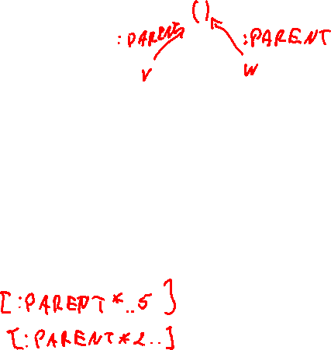
Combined patterns
(v)-->(w) v and w related by any relationship
(v)-[:PARENT]->()<-[:PARENT]-(w) v and w are siblings.
(v)-[:SPOUSE]->()-[:SPOUSE]->(w) Bigamy
(v)-[:SPOUSE*2]->(w) Same
(v)-[:PARENT*]->(w) Descendants of v, not including v
(v)-[:PARENT*1..5]->(w) Descendants up to 5 generations

Slide 6
Beware of *
(v)-[*]->(w) computes every path from v to w
Two paths:
({name: "Alice"}) -[:FRIEND]-> ({name: "Bob"}) -[:FRIEND]-> ({name: "Eve"})
({name: "Alice"}) -[:FRIEND]-> ({name: "Charlie"}) -[:FRIEND]-> ({name: "Eve"})
This can explode exponentially
Instead use MATCH p = shortestPath((v) -[*]->(w)) and relationships(p)

Slide 7
OPTIONAL MATCH
Like LEFT JOIN
Get all married couples: MATCH (v)-[s: SPOUSE]->(w) RETURN v, s, w
Get everyone including their marital status MATCH (v:Person) OPTIONAL MATCH (v)-[s: SPOUSE]->(w) RETURN v, s, w

Slide 8

RETURN
Like SELECT in SQL, but at the end instead
Grouping is automatic: RETURN c, COUNT(y) assumes you want to group on c
New aggregate function: COLLECT - creates a list of the values

Slide 9
WITH
Same options as RETURN, but used for intermediate results
Can be used to create local variables with constant values
Very useful for HAVING equivalents: WITH c, COUNT(y) as number WHERE number > 1
You may run into situations where WITH is needed as a bridge between two clauses:
ORDER BY must follow RETURN or WITH
WHERE must follow (OPTIONAL) MATCH or WITH

Slide 10
UNWIND
Like in MongoDB
Used when
you have a list but want individual nodes
you want to do something with a list that the list functions don't support: UNWIND list AS number WITH number ORDER BY number ASC RETURN COLLECT(number) AS list

Slide 11
WHERE
Like SQL
Most interesting is the use of EXISTS/NOT EXISTS: NOT EXISTS ((v)--(w)) means v and w are not related
WHERE can be used in patterns, which allows for things like NOT EXISTS ((v)--(w WHERE w.age < 18))

Slide 12
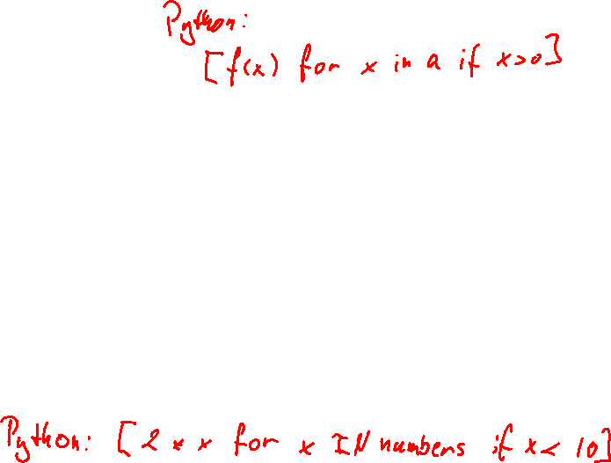
List comprehensions
Advanced feature
Allows you to create lists based on computations and selections from other lists
Can always be replaced with other clauses and UNWIND + COLLECT
Syntax: [x IN <list> WHERE …| <expression using x>] (WHERE is optional)
For example, the double of the numbers below 10: [x IN numbers WHERE x < 10 | 2 * x]

Slide 13
Pattern comprehension
Advanced feature
Create a list of elements matching a pattern (possibly including WHERE)
Can always be replaced with other clauses and COLLECT
A list of years of Keanu Reeves movies released: MATCH (a:Person {name: 'Keanu Reeves'}) RETURN [(a)-->(b:Movie) | b.released] AS years
Or: MATCH (a:Person {name: 'Keanu Reeves'}) --> (b:Movie) RETURN COLLECT(b.released) AS years

Slide 14
DELETE
Delete relationships: MATCH (…)-[e]-(…) WHERE … DELETE e
Delete nodes with no relationships (fails if they have relationships): MATCH (v …) WHERE … DELETE v
Delete node and all their relationships: MATCH (v …) WHERE … DETACH DELETE v

Slide 15
SET
Like SQL: MATCH … WHERE … SET v.name = "Joe"

